Slide 1
Career Development Seminar: When I Grow Up Personal Commericals Networking
Instructor: Margaret Roberts
Director, Eberhardt Career Management Center

Slide 2
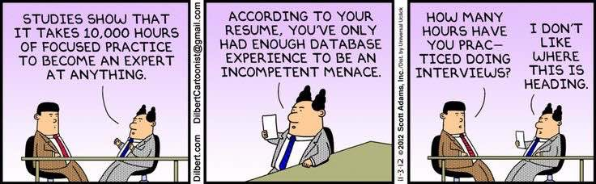

Slide 3
But first…
Mock Interviews – Biggest lesson learned from this?
Career Article Reflections – Quality generally high. Variable points for non-reflective submissions awarded now. See rubric for guidance on how these are evaluated.
Group projects – Detailed introduction on this in 3 weeks. Groups have been tentatively BUT some adjustments need to be made. Double concentrations and exploratory/undeclared folks please see me after class!

Slide 4
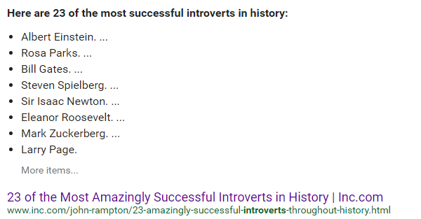
When I Grow Up I Want To Be a _____________________
Personality Assessment – How can this tool help answer this question?
Who’s life is it anyway? – Pressure from others to choose a particular path may not set us up for success.
I’m not an extrovert so I can’t be a ________.

Slide 5

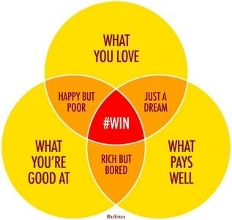

Confucius says…
“Choose a job you love, and you will never have to work a day in your life.“ – Confucius
Translated in 21st century terms:
Pursue opportunities that align to your passions, values, skills, education and goals – where these things collide you are likely to find the greatest fulfillment and success (including monetary).

Slide 6
Where/What is your Intersection?
EDUCATION & EXPERIENCE Formal degrees. Training. Credentials. Where/how you’ve gained your qualifications. | VISION What do you want to be known for?
SKILLS Transferable and marketable hard and soft skills which you most enjoy and want to use | VALUES What are the non-negotiable qualities you are looking for in positions and organizations (e.g., ethical, integrity, community engagement, reward performance, flexible work environment, entrepreneurial culture, etc.)
GOALS Promotions & growth? Six figure earnings? By when? Impact on people? Internal? External? Community impact? Global impact? | INTERESTS/PASSIONS How would you spend your time if you didn’t have to worry about money? Can you apply your marketable skills to these areas in a meaningful way and make a career out of it?
Career Action Plan: A strategy and plan of execution to arrive at this intersection.

Slide 7

Your Choices will Shape your Success
Entry-level careers are not graveyards, they are launching pads
Ask yourself and hiring manager – what can I learn in this role/position that will propel me to the next level? How will my success be measured and can my advancement be accelerated (or hindered) in this environment?
Always be learning!
Great companies invest in people to maximize their assets.
Enhance your value by investing in yourself - professional associations, industry groups, online/in-class courses – builds your skills and your network.
Take on special projects to expand your skill set.

Slide 8
Personal Commercials aka elevator pitch
I was born in Aromas, CA…
I’m a junior at University of the Pacific…
I’m a marketing major
Why are these not good opening statements to stand out?
‘Sell your brand’ and demonstrate your genuine curiosity
Show them you did your research

Slide 9
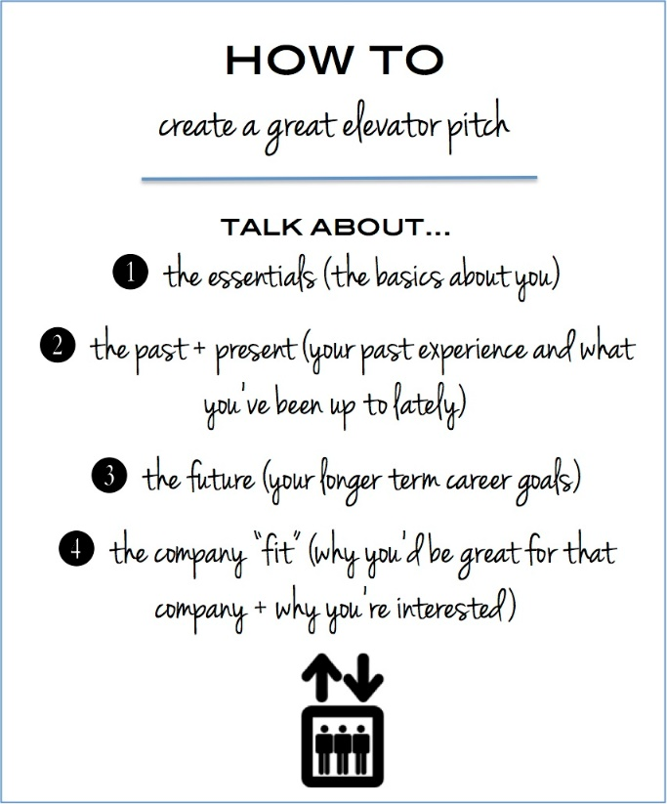

Slide 10
Make your own pitch
Take out a piece of paper and a pen/pencil.
Jot down ideas to formulate your elevator pitch.
Hi, I’m Margaret. Nice to meet you!
I’m looking for internships where I can get my hands dirty in real business problem solving in my last summer before I graduate with a business degree. In my finance courses we get a lot practice with formulas, models and business case analysis, but those are no substitute for the real thing.
I’d like to learn more about how financial decisions within (private / public / government) companies are made from a first hand perspective. I know this will help me figure out what areas of corporate finance to pursue in the future to reach a longer term goal of heading up finance for a business unit or company.
As I was looking into your company I discovered places a high value on Corporate Social Responsibility and encourages community service and outreach. I’d love to know more about your internship program and financial analyst career paths because I can see myself really at a company like (name company).

Slide 11

Turn to your neighbor and try your pitch on for size

Slide 12
Another practice opportunity before the career fair
Monday, Feb 27th – Gallo Sales recruiters & alumni will be here to offer an employer perspective on how candidates can stand out at career events
Be PREPARED with your elevator pitch to introduce yourself to one of the reps at the end of the class
REMEMBER TO DRESS IN BUSINESS CASUAL ATTIRE

Slide 13
It is mostly about WHO, not what, you know
First job I ever got was through a referral (15 ½ yrs old)
First job out of college was through a referral (from internship I did with another branch of the company)
Next 3 jobs I had were through referrals
All of my freelance resume writing and recruitment consulting work has been through referrals
This job at Pacific is the only post-college job I have ever landed without a referral!

Slide 14
Networking… Numbers don’t lie
Various studies have found that 45% to 70% of job seekers got their jobs through networking.
Employers prefer to hire through referrals because it improves retention and a hire you know is less risky!
At many top employers, referred candidates get fast-tracked, applicants from other sources like corporate Web sites, Internet job boards and job fairs sink to the bottom of the pile. (Source: http://www.nytimes.com/2013/01/28/business/employers-increasingly-rely-on-internal-referrals-in-hiring.html?pagewanted=all&_r=1&)

Slide 15
Focus on ‘warm’ markets, not cold calling
Classmates / Alumni
Friends of friends / Friends of family
Current / former colleagues
Don’t ask for a job, gather information!
Many of the people you network with will not be in a position to hire you, but can influence the hiring decision makers!

Slide 16
Practice makes perfect
Very few people LOVE networking but most of us can become pretty good at it
It will feel awkward the first couple or few times
As a college student and young professional you can really stand out by making the effort – most of your peers won’t bother

Slide 17
No class next week!
Enjoy the holiday!
Refer to Canvas for online content and assignments!
See you on Feb 27th – GUEST SPEAKERS from Gallo Sales!

